Slide 1
Gauthami Techno School
Annual Day Synergy
(2023-24)

Slide 2
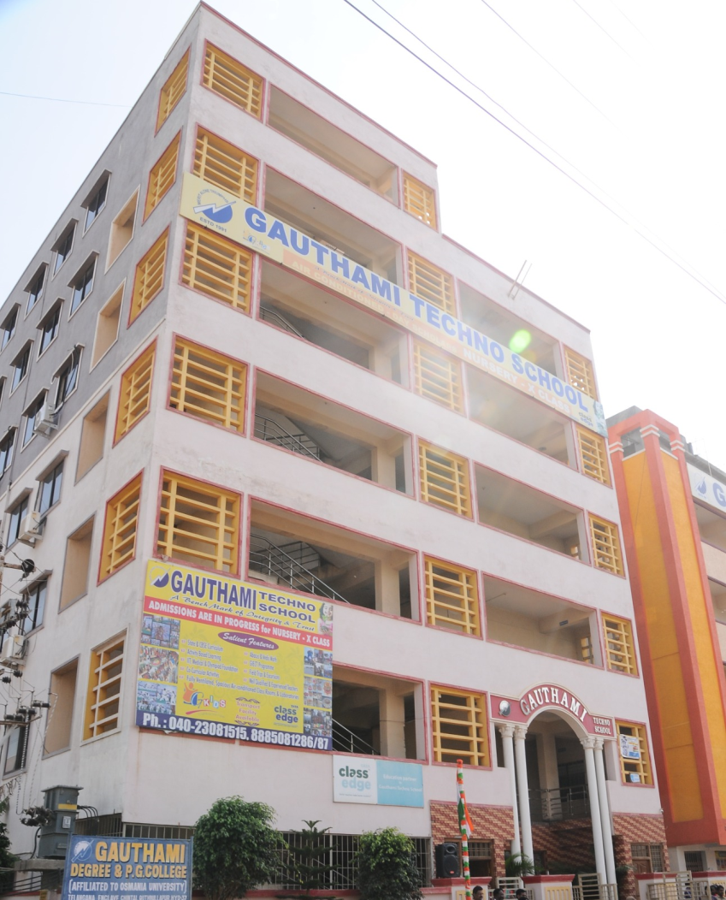
CULTURAL PROGRAMMES
Shiva Thandavam
Buzzy Bees
Dazzling Disc
Magadheera masquerade

